Slide 1
Ministry of Higher Education Kabul university faculty of Information & communication technology
Introduction to C ++ Programming

Slide 2

Overview
History of C++
What is C++?
Why Learn C++?
Key Features
Applications of C++
Procedure Oriented Programming
Need of Object-Oriented Programming
features of Object-Oriented Programming
Comparison of Procedural and Object-Oriented Approach
Advantages and disadvantages of OOP
Application of OOPs

Slide 3
History
Developed by Bjarne at Bell Labs in the early 1980s.
The first commercial release of C++ was in 1985.
Significant milestones:
C++ continues to evolve, with new standards and updates addressing the needs of modern software development

Slide 4

What is C++?
Originated as an extension of the C programming language, known as "C with Classes."
An extension of the C programming language with additional features such as classes and objects.
Often referred to as a "middle-level" programming language because it combines both low-level and high-level language features.

Slide 5
Why Learn C++?
Widely used in various domains such as system/software development, game development, and embedded systems.
Provides a strong foundation for learning other programming languages.
Offers greater control over system resources compared to high-level languages like Python or Java.
Excellent performance due to its close-to-the-hardware nature.

Slide 6
Key Features
Object-Oriented: Supports concepts like classes, objects, inheritance, and polymorphism.
Platform Independent: Code written in C++ can be compiled to run on different platforms.
Strongly Typed: Requires explicit type declarations, promoting type safety.
Standard Template Library (STL): Provides a rich set of data structures and algorithms.
Memory Management: Offers both automatic and manual memory management.

Slide 7
Applications of C++
System/Software Development: Operating systems, compilers, database systems.
Game Development: Many game engines and Video games are written in C++.
Embedded Systems: C++ is commonly used in firmware and device driver development.
Financial Systems: High-frequency trading platforms and banking software.
Graphics and Animation: Graphics libraries like OpenGL and DirectX are often used in C++.

Slide 8
Procedure Oriented Programming
Conventional programming language using high level language such as Cobol and C, is commonly known as Procedure Oriented Programming (POP).
In Procedure Oriented Programming, the problem is viewed as a sequence of a thing to be done.
The primary focus is on functions.
Procedure Oriented Programming basically consists of writing a list of instructions for the computer to follow, and organizing these functions into groups known as functions.
In a multi-function program, many important data items are placed as global so that they may be accessed by all the functions.
Each function may have its own local data.

Slide 9
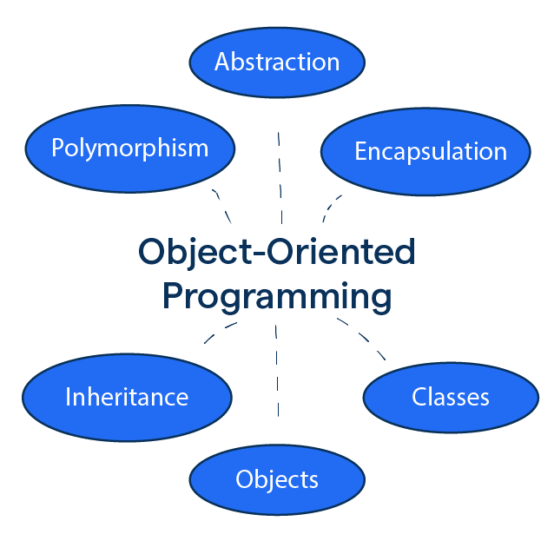
Introduction to OOPs
Object-Oriented Programming (OOP) is a programming paradigm in computer science that relies on the concept of classes and objects
It is used to structure a software program into simple, reusable pieces of code blueprints (usually called classes)

Slide 10
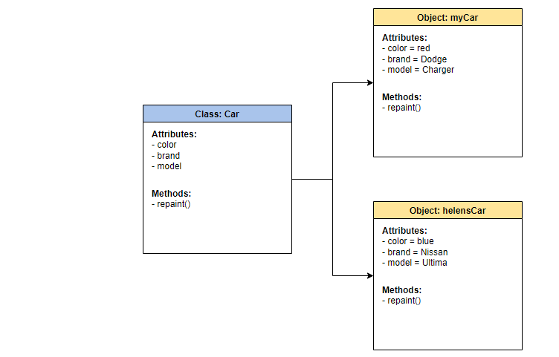
Class and object
A class is a user-defined data type in C++ that serves as a blueprint for creating objects. It encapsulates data (attributes) and functions (methods) that operate on that data.
An object is an instance of a class.

Slide 11
Object Oriented Programming
Object Oriented Programming is the most recent concept among programming model.
The motivating factor in the invention of object-oriented approach is to remove some of the flows encountered in the procedural approach.
It binds data more closely to the functions that operate on it and protects it from accidental modification from outside functions.

Slide 12
Need of Object-Oriented Programming
Developments in software technology continue to be dynamic. New tools and techniques are announced in quick succession
This has forced the software engineers and industry to continuously look for new approaches to software design and development, and they are becoming more and more critical in view of the increasing complexity of software system as well as the highly competitive nature of the industry.

Slide 13
features of Object-Oriented Programming
Encapsulation is the bundling of data, and the methods that operate on that data, into a single unit called an object.
Inheritance is a feature that allows one class (the child class) to inherit the properties and methods of another class (the parent class).
Polymorphism is a feature that allows one interface to be used for a general class of actions. This means that the exact method that gets called is determined at runtime, not at compile time.
Abstraction is a feature that allows complex real-world problems to be simplified by modelling them in a way that captures only the relevant details.

Slide 14
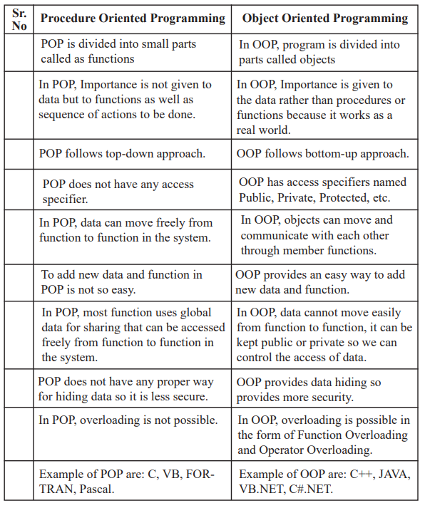
Comparison of Procedural and Object-Oriented Approach

Slide 15
Advantages of OOPs
Code reusability in terms of inheritance.
Object-oriented system can be easily upgraded from one platform to another.
Complex projects can be easily divided into small code functions.
The principle of abstraction and encapsulation enables a programmer to build secure programs.
Software complexity decreases.
Principle of data hiding helps programmer to design and develop safe programs.
Rapid development of software can be done is short span of time.
More than one instance of same class can exist together without any interference.

Slide 16
Disadvantages of OOP
It is not suitable for all types of problems.
OOPS can make the code harder to understand, debug, and test
consume more CPU resources than other paradigms, such as procedural.
Difficult to learn

Slide 17
Application of OOPs
Image Processing
Pattern Recognition
Computer Aided Design and Manufacturing
Computer Aided Teaching
Intelligent Systems
Database Management Systems
Web-based Applications
Distributed Computing and Applications
Data security and management
Mobile Computing
Parallel Computing

Slide 18
Thanks

